Slide 1


AI Agents Bootcamp 2025
Day 3 – Advanced Architectures & Optimization
📍 UTM – Chișinău
📅 25 June 2025
by Braga Basil

Slide 2
Today's Objectives
1
Deepen understanding of agent memory and knowledge
2
Implement advanced Retrieval-Augmented Generation (RAG)
3
Add tools to agents (API, browser, code execution)
4
Optimize performance using Ray, batching, and model choice
5
Build version-controlled, task-solving agent teams

Slide 3
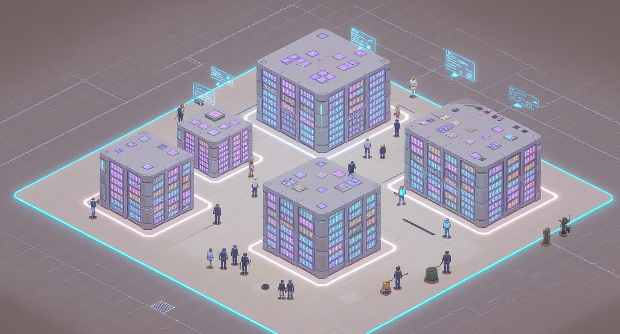




What is Agent Memory?
Agent memory = what the agent remembers and uses to make decisions
Short-term
Active during the current task
Long-term
Persistent across sessions
CrewAI supports memory via SQLite and Chroma by default
Shared
Accessible to multiple agents
Specialized
Unique to each role

Slide 4
Adding Memory in CrewAI
Use memory=True in your agent config.
agent = Agent( role="Researcher", goal="Summarize key ideas", memory=True, llm="ollama/deepseek")crew = Crew(agents=[agent], tasks=[...])crew.kickoff()
LLM: any Ollama-supported SLM (phi3, deepseek, etc.)
Trace agent reasoning with logging
Memory is persistent — inspect and reuse it in future tasks

Slide 5

What is Advanced RAG?
RAG = Retrieval-Augmented Generation
It combines LLMs with embedding-based document search
Use cases:
Let agents cite and pull from documents
Use multi-source retrieval (docs, APIs, web)
Inject role-specific or real-time knowledge
Popular tools: ChromaDB, FAISS, LangChain retrievers

Slide 6
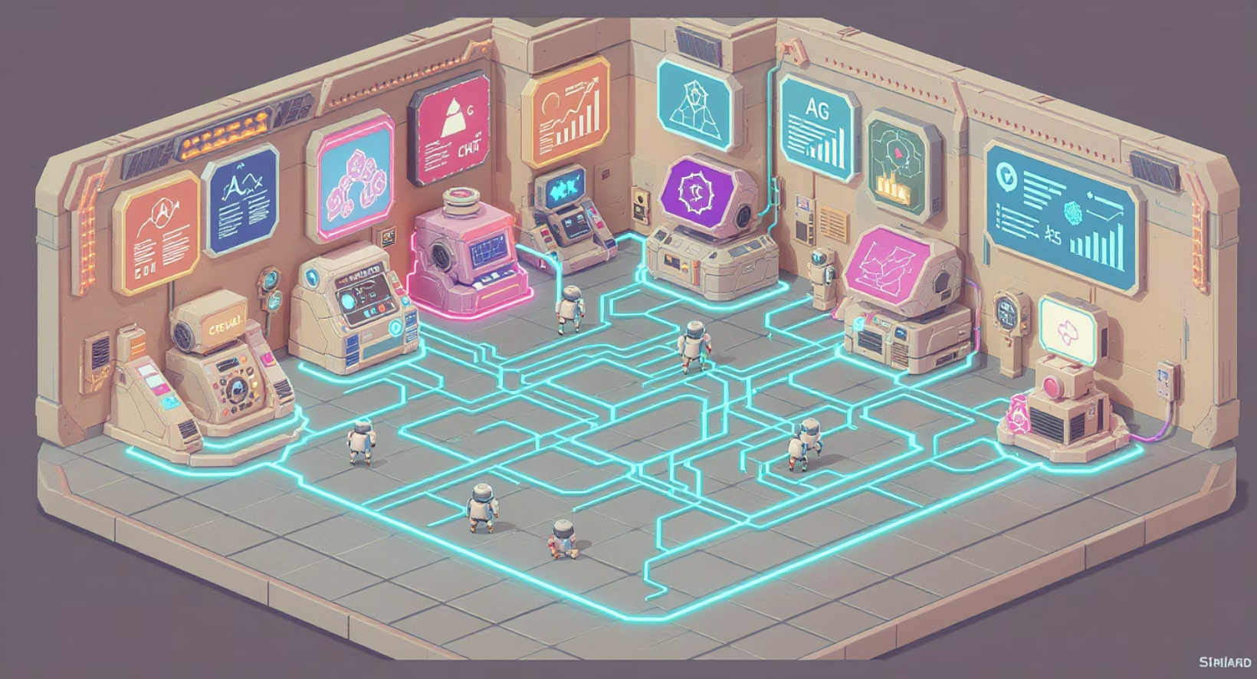
RAG Integration in Frameworks
1
CrewAI: plug in a retriever agent
2
LangChain: use tools + memory graph
3
Autogen: inject RAG context manually
4
LangGraph: use RAG nodes in a persistent workflow
Watch out for:
Token limit overflows
Embedding mismatch
Stale document caches

Slide 7
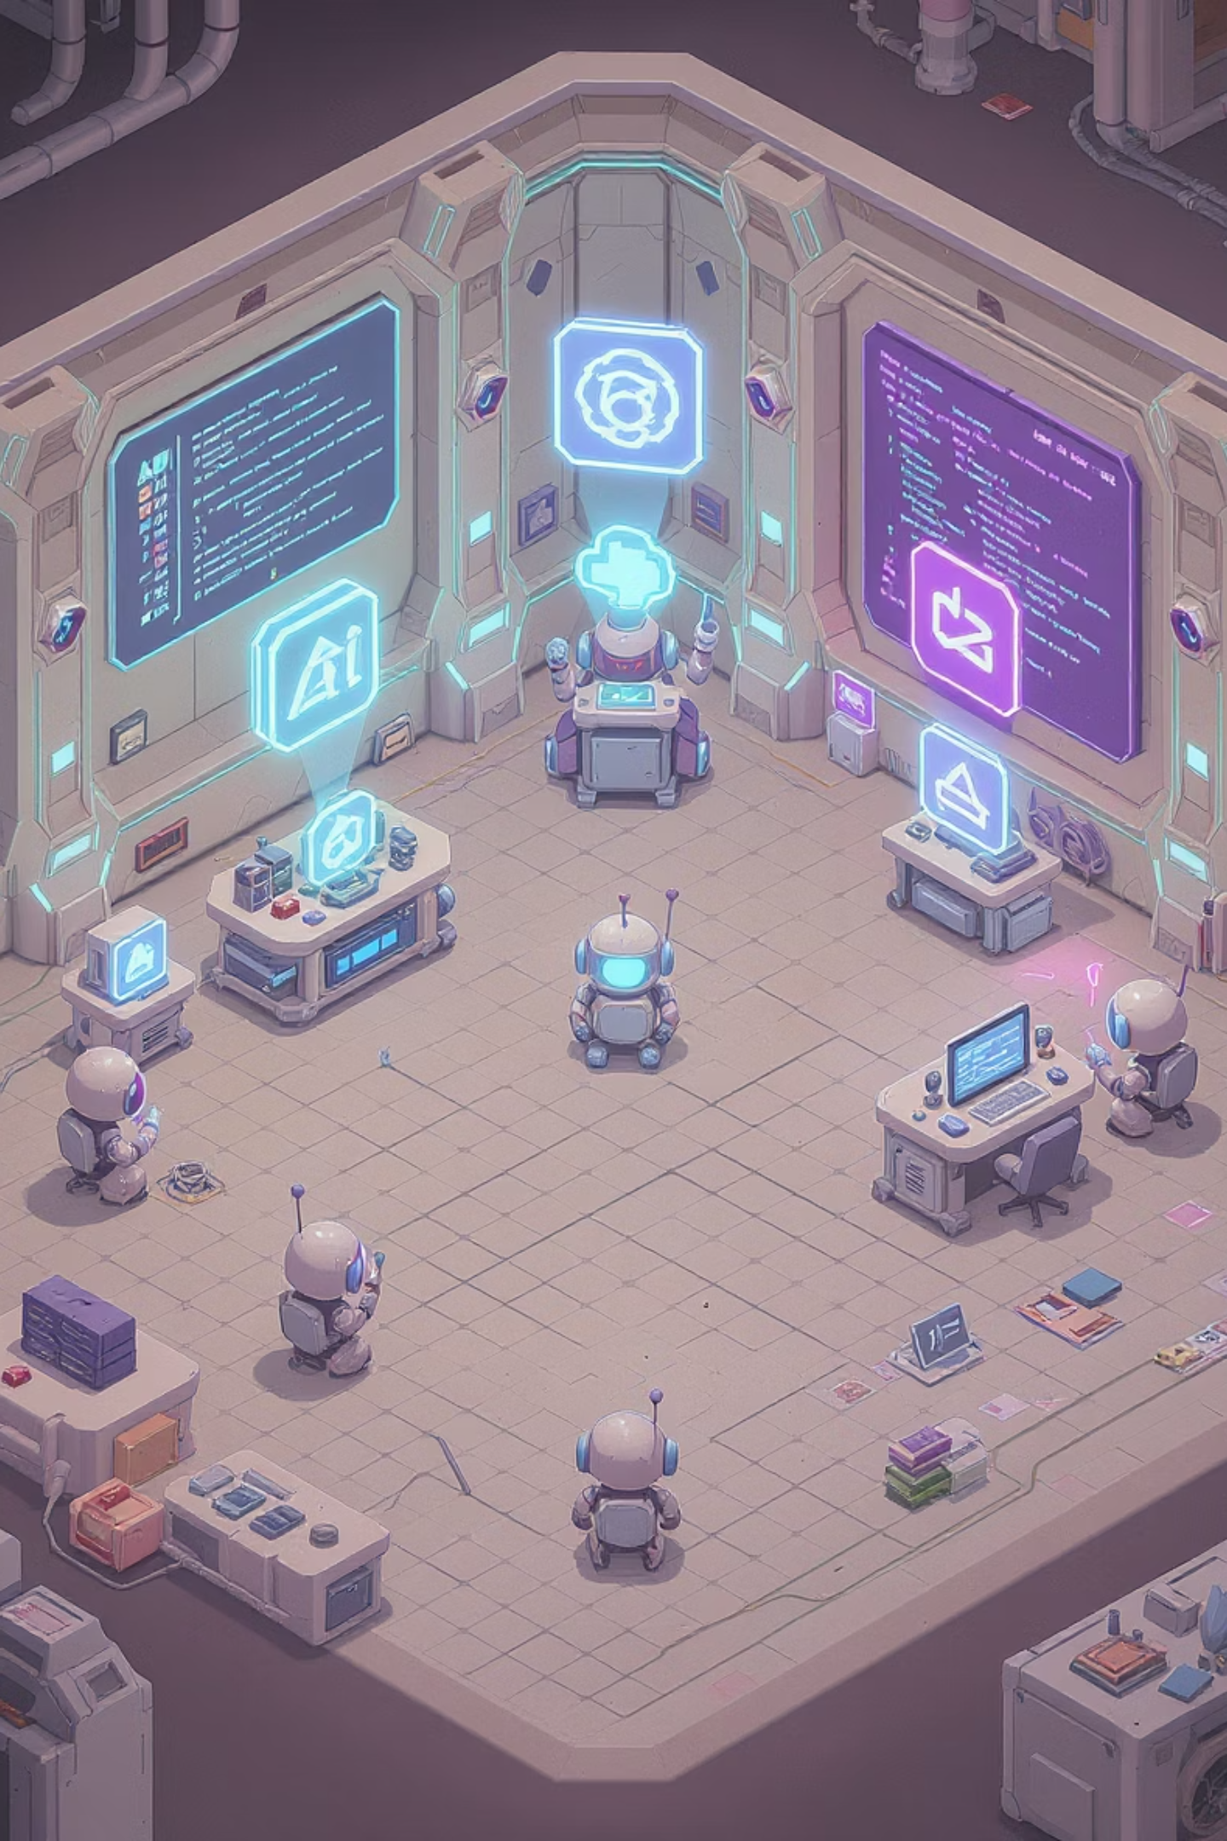




Agent Tools: Give Agents Hands
Agents can use tools to take real action
API Caller
Interact with external systems
Browser
Fetch information from the web
Code Executor
Run Python or shell scripts
File Tools
Read/write and summarize data
Tools are defined in your agent setup and invoked during task flow
Example: agent = Agent(..., tools=[api_tool, browser_tool])

Slide 8





Tool Execution Flow
Agent plans next step
Decides to use a tool
Sends input to tool
The agent evaluates the current state and determines what action to take next
Based on the task requirements, the agent selects an appropriate tool
The agent formats and provides the necessary input parameters
Receives output and updates memory
Continues reasoning or switches task
Tool results are processed and stored in the agent's memory
Based on the tool output, the agent decides on the next course of action
Tool results can be logged, reused, or passed between agents

Slide 9
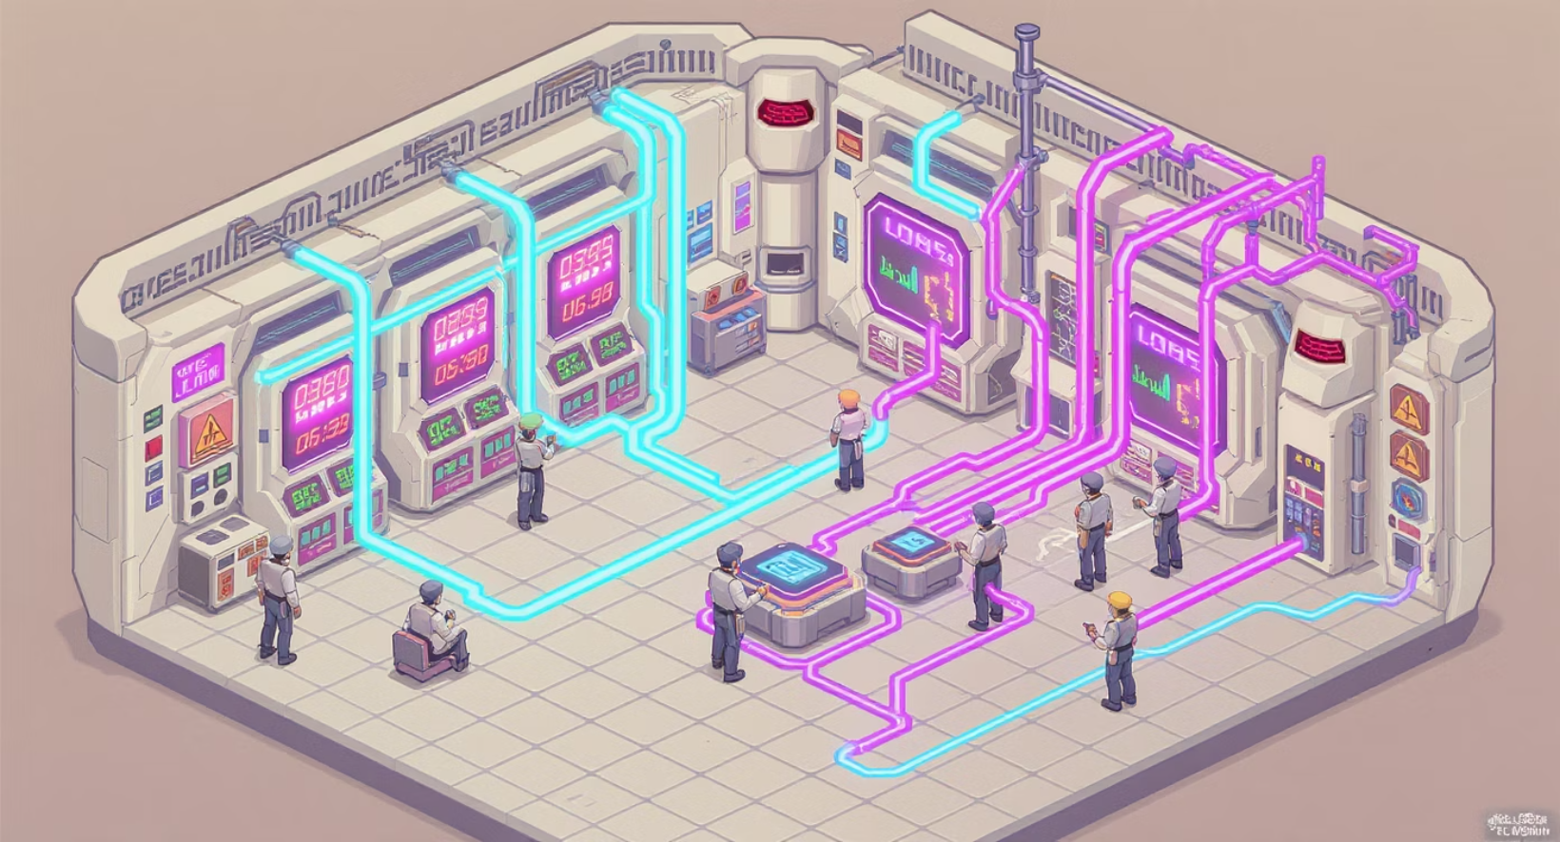
Optimizing Performance
Small Language Models (SLMs) are efficient, but we can do better
1
Performance techniques:
Ray for parallel agent execution
Ollama batching for faster local inference
Use smaller models when possible
Reduce prompt size and reuse shared memory
Always balance cost, speed, and accuracy

Slide 10
Measure and Log
Track your system's performance
Log:
start = time.time()# Agent execution hereend = time.time()print("Execution Time:", end - start)
Execution time per agent
Tool calls and responses
Memory updates
Failures or timeouts
Benchmarking helps you debug and optimize your MAS setup

Slide 11
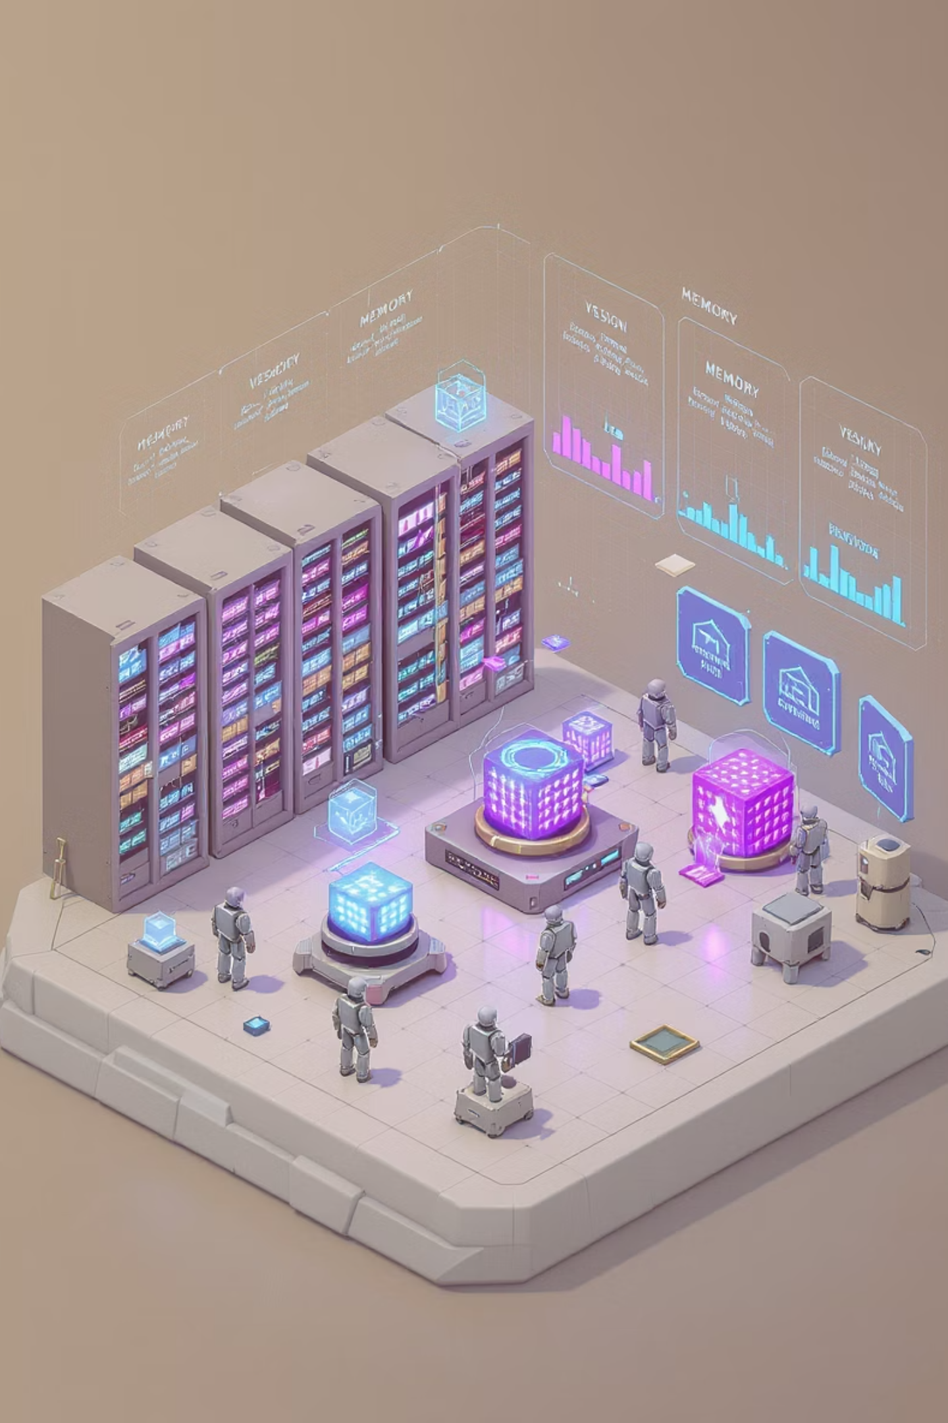



Versioning Agent Knowledge
Why version memory?
Compare reasoning across sessions
Store and reload knowledge as JSON, SQLite, or Chroma
Detect changes in agent behavior over time
Best practice: save a snapshot of agent memory after each major task

Slide 12
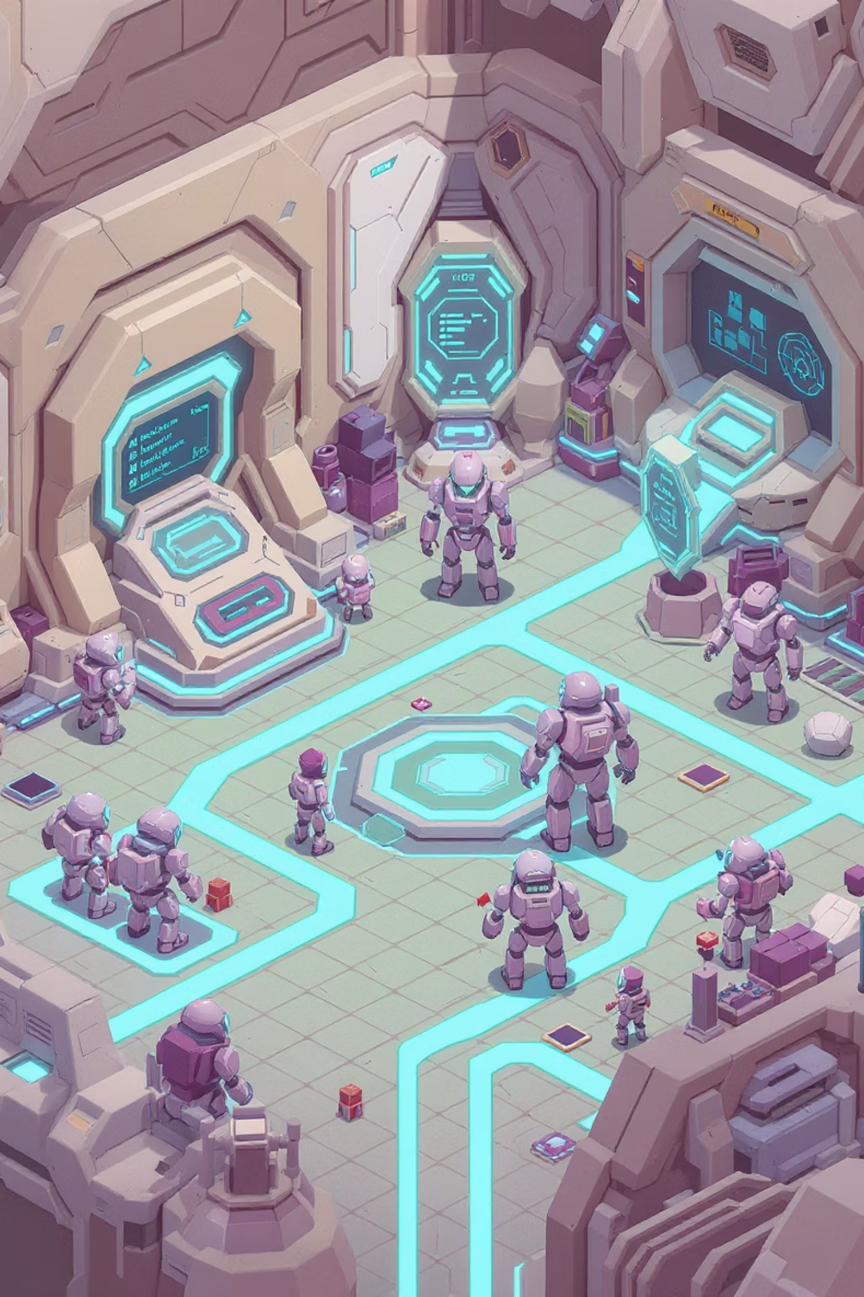
Day 3 Hands-On Challenge
Your task: build a smarter multi-agent system
Requirements:
At least 3 agents with defined roles
Use RAG for document knowledge
Each agent should use at least one tool
Enable memory and export it
Log decisions and version trace
Bonus: deploy your system with Gradio + ngrok

Slide 13
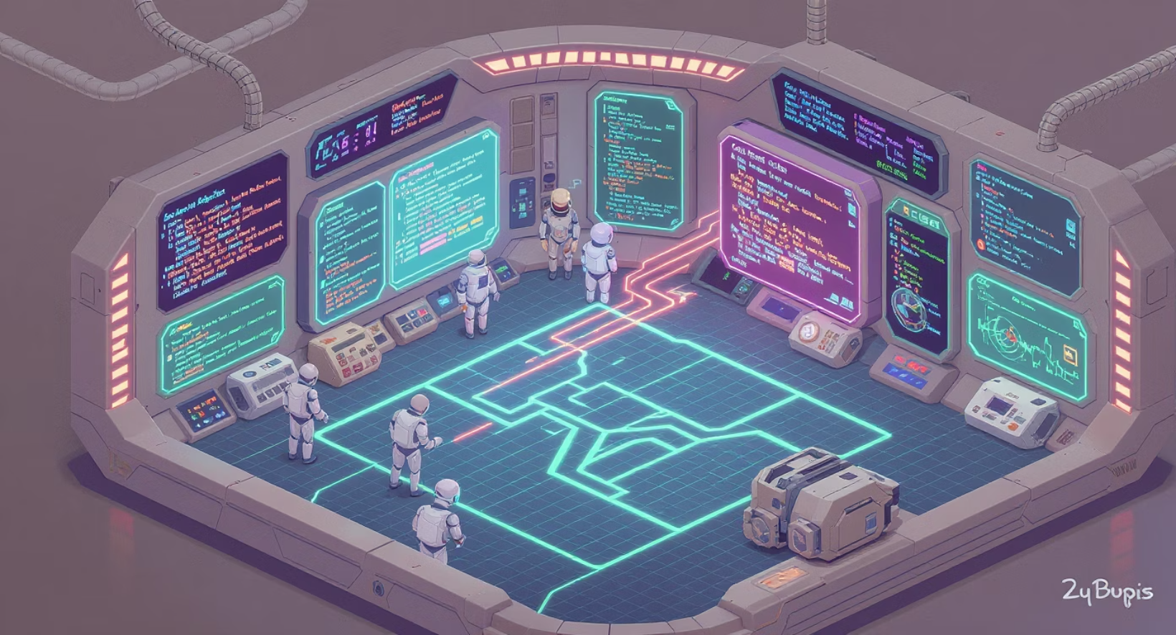
Debugging Smart MAS
If something breaks, ask:
What did the agent know at each step?
Was memory updated as expected?
Did the tool call return anything?
Was the prompt too long?
Good logs = better debugging
Add intermediate prints and memory dumps

Slide 14

Wrap-Up and What's Next
1
✅ You learned: memory design, RAG setup, tool integration, performance optimization
2
✅ You built: agents that remember, reason, and act
3
✅ You tracked: logs, tools, and agent versions

